Slide 1
Chapter 13: Properties of Solutions
Dr. Aimée Tomlinson
Chem
1212

Slide 2

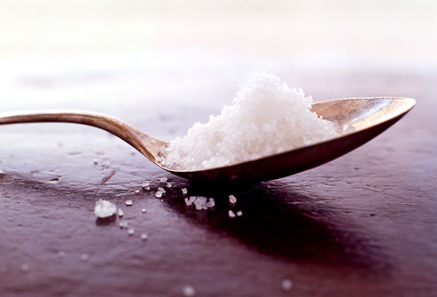
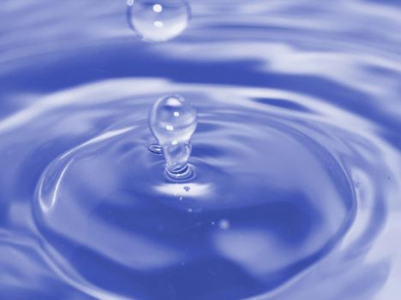
What is a solution?
Solutions are formed from the addition of two species
Solute: dilute species
Solvent: abundant species
Solution
+
=
www.webmd.com/diet/slideshow-salt-shockers
thegldc.com/blog/tag/water/
gusville.com/index/LIS753/images/

Slide 3
Section 13.1
The Solution Processes

Slide 4
Universal Solution Rule
Like dissolves Like
Polar/ionic species require polar solvent
Nonpolar compounds require nonpolar solvents

Slide 5
Intermolecular Forces &
Solution Formation
In order to form a solution:
We must break apart intermolecular forces of both the solute and solvent molecules
Once they are far enough apart from themselves they are free to form new interactions with each other

Slide 6
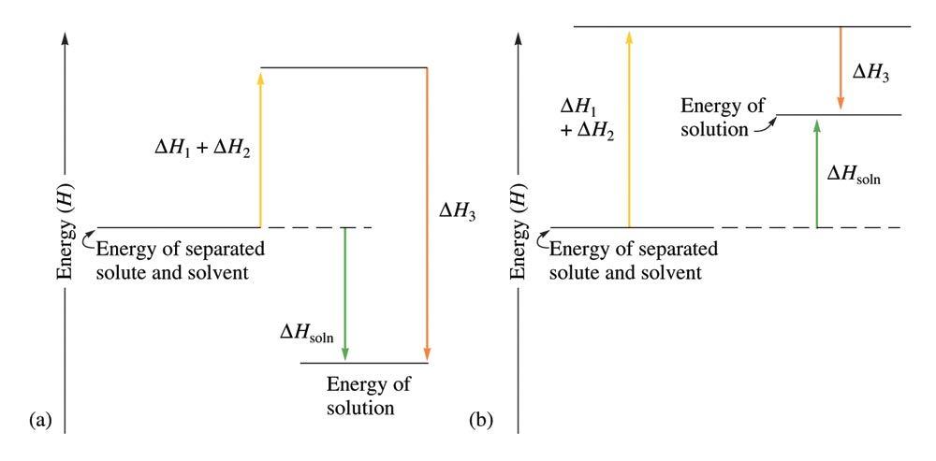
Energy Steps in Solution Formation
Step 1: solute is separated into its individual components – endothernic, ΔH₁
Step 2: IF between solvent molecules are broken – endothermic, ΔH₂
Step 3: IF are generated between solute and solvent – exothermic, -ΔH₃
On the left we have ΔH_{solution} < 0
Solute is completely soluble
E.g. NaCl in water
On the right we have ΔH_{solution} > 0
Solute is only partially soluble
E.g. CaSO₄ in water

Slide 7

Solution Formation &
Chemical Reactions
Things to keep in mind:
The solvent and solute do not change chemical composition when a solution is formed
All that changes are the intermolecular forces
X 2

Slide 8
Section 13.2
Saturated Solutions & Solubility

Slide 9
Crystallization & Saturation
Crystallization is the formation of solid crystals in a solution
Only differs from precipitation by size of crystals and the speed of the process
The solution-making process and crystallization are opposing processes.
When the rate of the opposing processes are equal, additional solute will not dissolve unless some crystallizes from solution. This is a saturated solution.
If we have not yet reached the amount that will result in crystallization, we have an unsaturated solution.

Slide 10
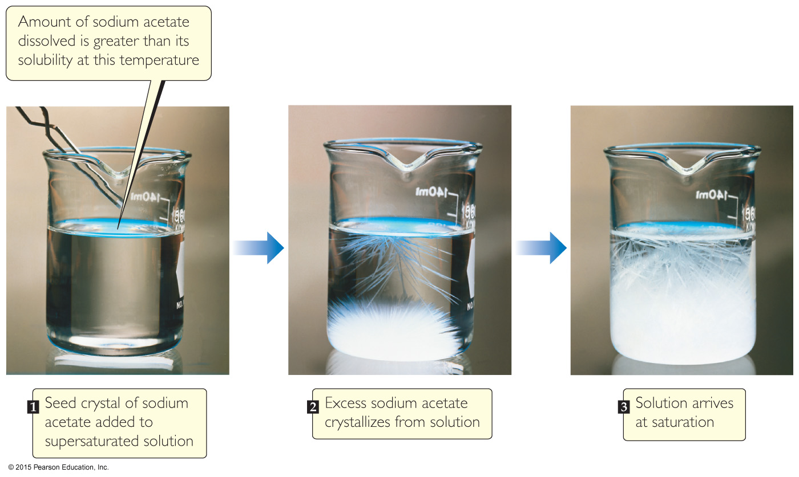
Supersaturated Solution
In supersaturated solutions, the solvent holds more solute than is normally possible at that temperature.
These solutions are quite unstable and will crystallize/precipitate or crash quickly out of solution by scratching the side off the flask or with cooling

Slide 11
Section 13.3
Factors that Affect Solubility

Slide 12
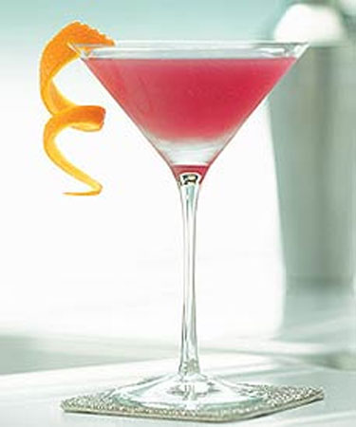
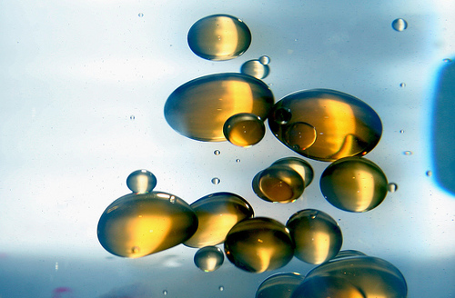
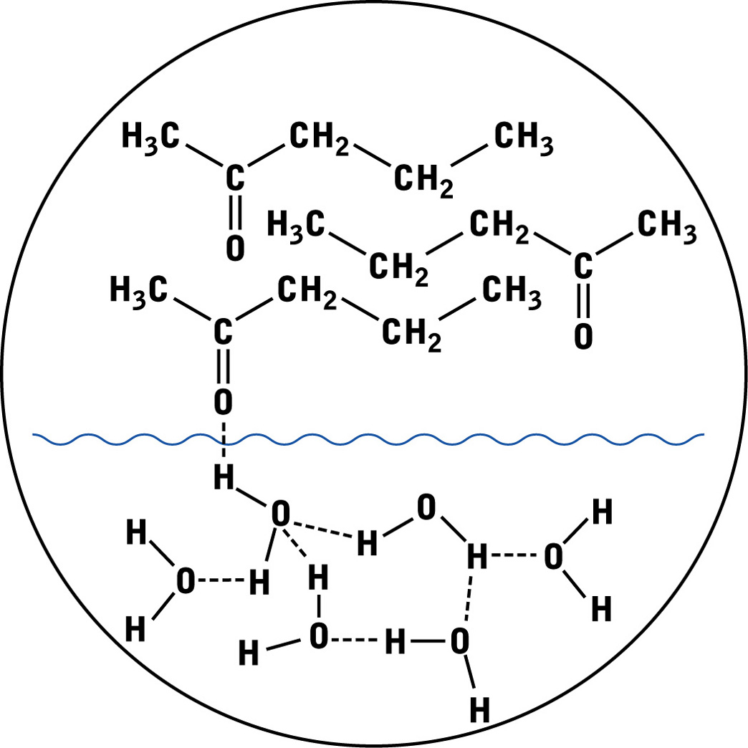
Chemical Structure
Miscibility
How well two substances mix together
www.bridalwave.tv/alternative_hen/
Immiscibility
When two substances do not mix together
novocreamseparators.com/blog/clean-separation/
Partial Miscibility
Hydrophilic component will mix in water while hydrophobic part won’t
The longer he hydrophobic chain the less miscible it will be in water

Slide 13
Pressure
Primarily important for gases dissolved in solvent
Henry’s Law: gas solubility is directly proportional to gas pressure
  Mathematically: C_{gas} = k_{H}P_{gas}
where C_{gas} is concentration of the gas in solution
k_{H} is Henry's constant for this gas in a particular solution
  As we increase the pressure we increase the number of gaseous moles we can push into solution
  The opposite is also true, reduce P we reduce concentration

Slide 14
Example Calculation
Calculate the solubility of oxygen in water at 20°C and an atmospheric
pressure of 0.35 atm. The mole fraction of O₂ in the air is 0.209 and
k_{O2} = 1.3 x 10⁻³ mol/L*atm. (Answer: 9.5 x 10⁻⁵ M)

Slide 15
Temperature
We have already mentioned that we can increase T to force mixing between compounds
I should point out that if we are trying to mix polar and nonpolar species no amount of heat increase will ever cause miscibility
Previously, I eluded to the idea that the sign ΔH_{soln} of is a predictor as to the solubility of two species
  whille it is true to some extent there are many other factor which must also be considered
  to be technically correct we must perform experiments to truly determine the extent of miscibility or immiscibility of two species
X 4

Slide 16
Section 13.4
Expressing units of Concentration

Slide 17
Measuring Solute to Solvent
Molarity
Mass Percent/Percent by weight
Mole Fraction
Parts per Million, ppm
Molality

Slide 18
Section 13.5
Colligative Properties

Slide 19
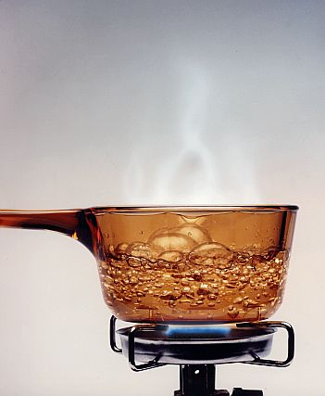
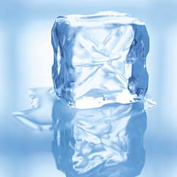
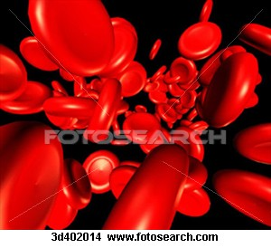
Here they are …
Vapor Pressure/
Boiling Point Elevation
Freezing Point
Depression
Osmotic Pressure
http://cirellio.files.wordpress.com/2008/06/boiling-water.jpg
www.blog.thesietch.org/.../

Slide 20
Vapor Pressure

Slide 21
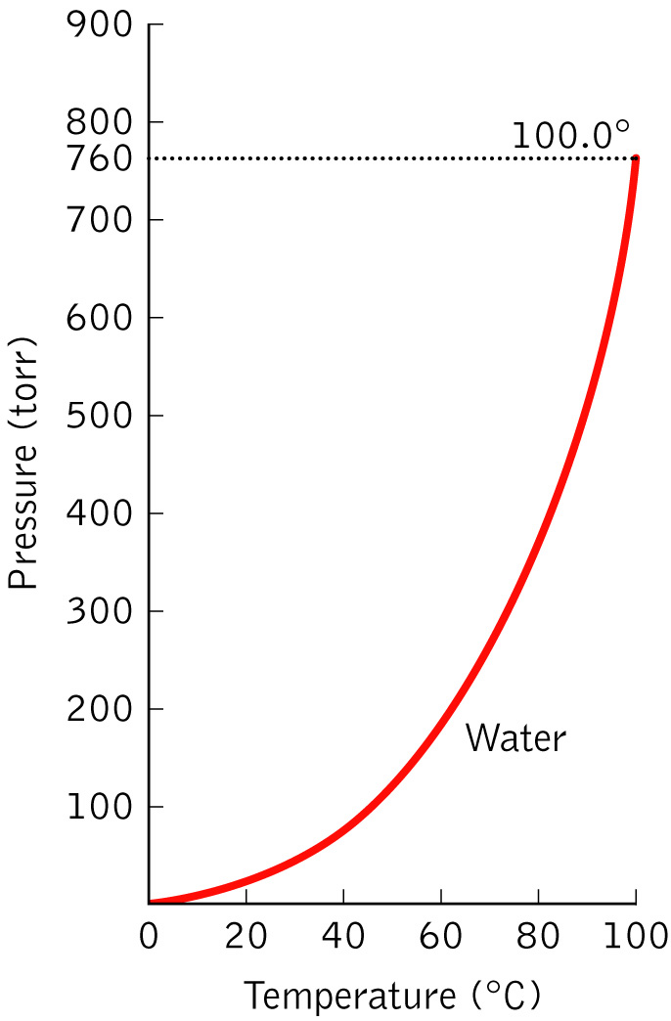
Vapor Pressure & Temperature
VP increases as T increases
When T increases so do the molecular motions & kinetic E eventually allowing molecules to escape from l to g
RULE: to go from l → g, VP must equal atmospheric P
At higher elevations there is less atmospheric P so less heat is needed to boil (why water will boil below 100⁰C in Denver

Slide 22
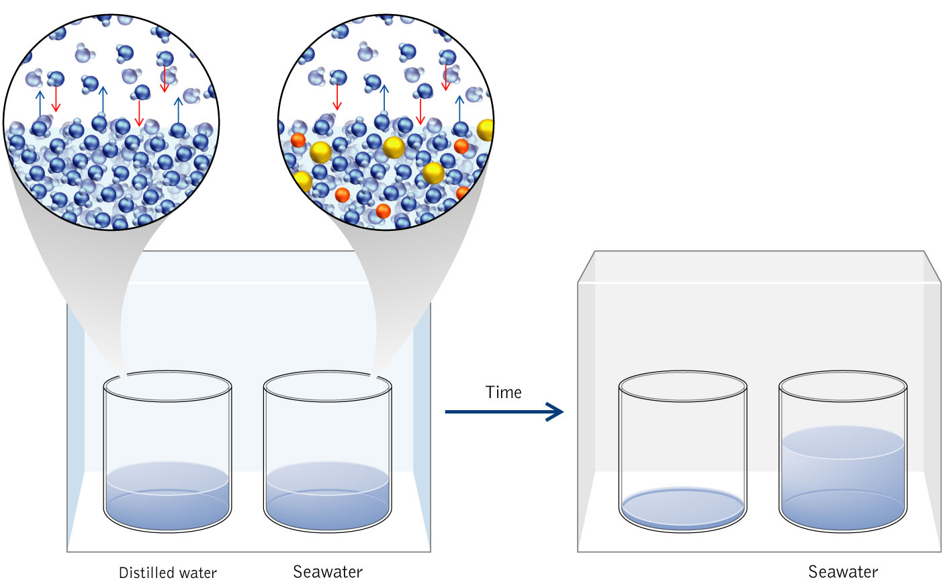
Experiment – DI water vs Seawater
Over time, DI water is reduced as seawater increases
Water escapes from DI beaker faster
DI water liquefies back into the salt water beaker
  The driving force is water wants to solvate salt
  Recall ion-dipole forces are stronger (more stable) than Hbonding
  This is why we use dessicator packets to protect leather goods

Slide 23
TAKEHOME MESSAGE
The presence of a nonvolatile solute lowers the VP of a solvent

Slide 24
Calculating Vapor Pressure
We use Raoult’s Law:
Example problem: What is the vapor pressure of water in a 50:50 mixture of glycerol (D_{C3H8O3} = 1.261 g/mL) and water at 25°C (P_{H2O} = 23.8 torr)? (Answer: P_{soln} = 191.1 torr)

Slide 25
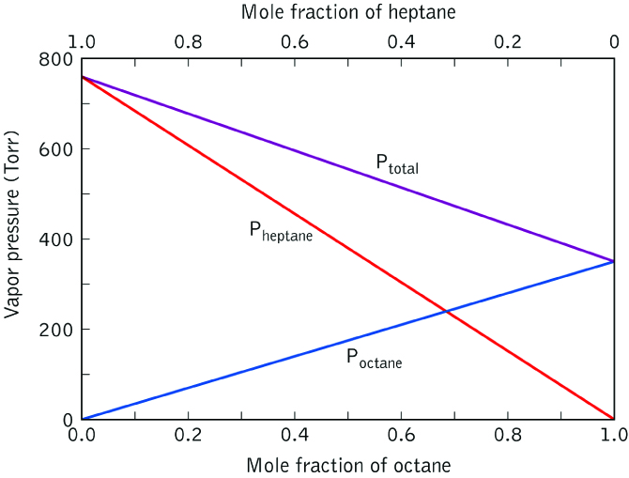
Vapor Pressure for Volatile Mixtures
Petroleum Industry
Oil is composed of a number of different hydrocarbons
These all have similar but different boiling points
They can be separated through fractional distillation
Raoult’s Law for a Volatile Mixture:
All ideal solutions obey this Law
Example for Ideal Solution: Octane & Heptane
They possess the following similarities:
Size
Boiling point
Intermolecular forces (solute-solute,
solvent-solvent, and solute-solvent

Slide 26
Example of Volatile Mixture
At 20°C, the VP of ethanol is 45 torr and the VP. of methanol is 92 torr.
What is the VP at 20°C of a solution prepared by mixing 75g of methanol and 25g of ethanol? (Answer: P_{soln} = 83 torr)
Notes:
Put kahoot here

Slide 27
Boiling Point Elevation
&
Freezing Point Depression

Slide 28
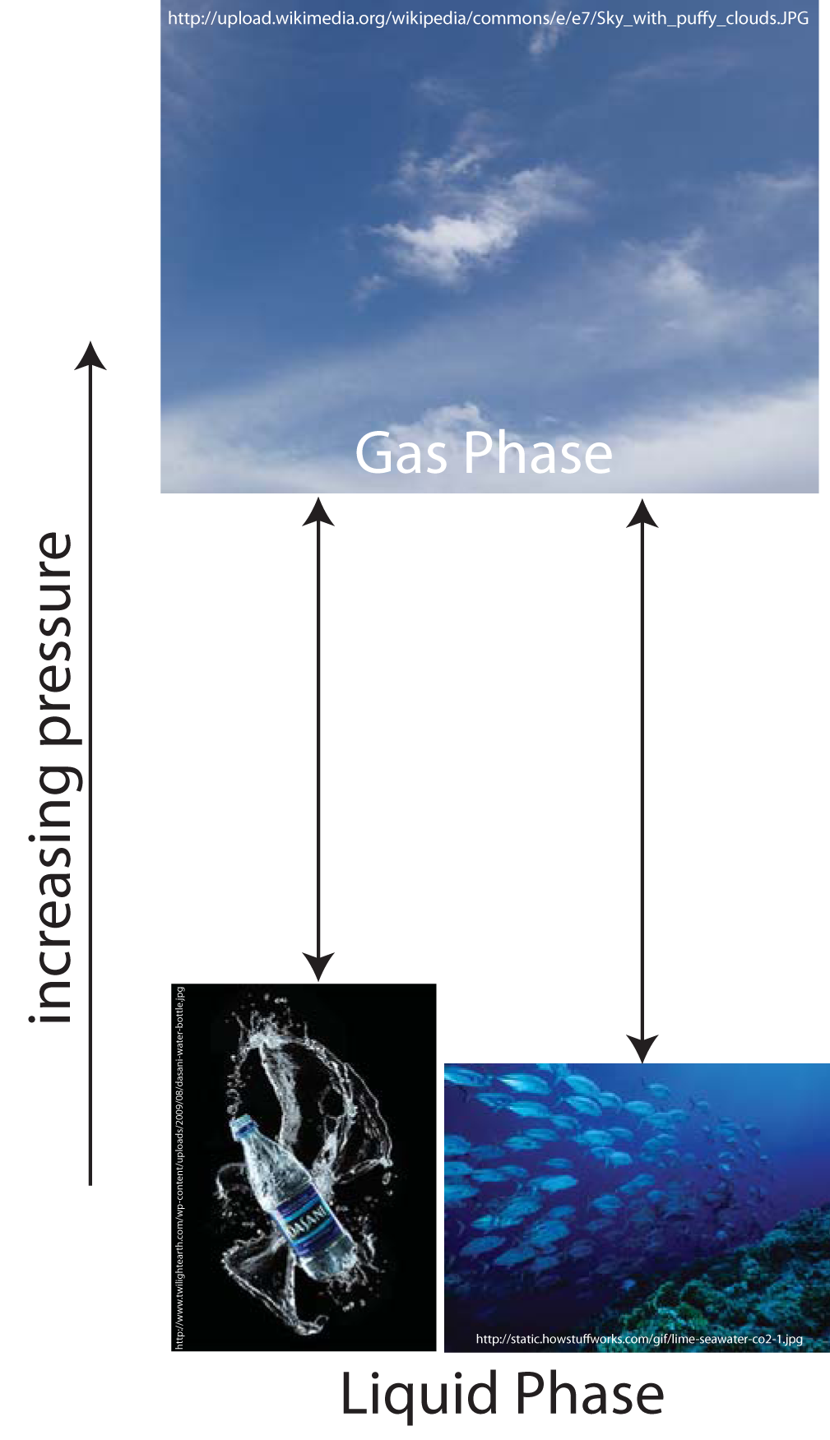
Reminder: VP & Bpt Relationship
At boiling VP = P_{atm}
Recall Seawater Experiment
The salt lowered VP of water
This makes a larger energy gap to reach P_{atm}
A larger gap means more heat required to boil

Slide 29
TAKEHOME MESSAGE II
The presence of a nonvolatile solute raises the boiling point of a solution

Slide 30
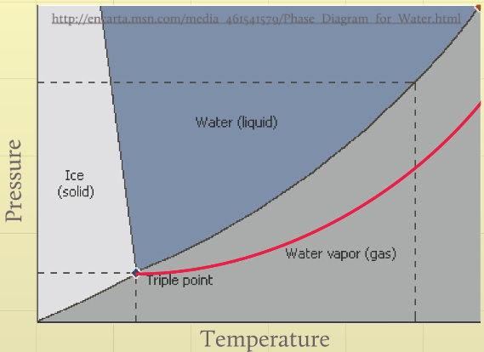
Boiling Point Elevation
Boiling point line is shifted when nonvolatile solute is added
Mathematically:
where ΔT_{b} is the change in boiling point, K_{b} is a constant, and
m_{solute} is the molality of the solute in solution

Slide 31
Example Bpt Elevation Problem
If the boiling point of a sample is 2.3 Celcius above the boiling point of pure water, what is the molality of NaCl in the sample?
(Answer: 4.4 m NaCl)

Slide 32
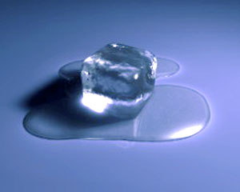
Freezing Point Depression
Similar to Boiling Point
Salt melts ice by lowering the VP
This makes the freezing point lower
Lowering freezing point ends up allowing water to melt above its normal freezing point T
Mathematically:
www.uniongas.com/images/meltingIcetechnology.jpg

Slide 33
Osmotic Pressure

Slide 34
Osmosis
When solvent passes through a semipermeable membrane to balance the solute concentrations on each side of the membrane

Slide 35
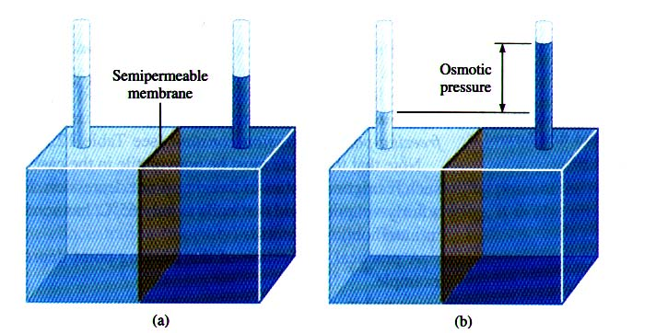
Osmotic Pressure
amount of pressure needed to stop the solvent from following to the more concentrated side of a semipermeable membrane
http://nanotech.sc.mahidol.ac.th/genchem/liquid1/osmo.jpg

Slide 36
Easy Example Problem
Calculate the osmotic pressure across a semipermeable membrane separating seawater (1.14 M) from a solution of normal saline (0.31 M) at a T = 20°C. (Answer: 20 atm)

Slide 37
Difficult Example Problem
A solution was made by dissolving 5.00 mg of hemoglobin in water to give a final volume of 1.00 mL. The osmotic pressure of this solution was 1.91 x 10⁻³ atm at 25 ºC. Calculate the molar mass of hemoglobin. (Answer: 6.41 x 10⁴ g/mol)

Slide 38
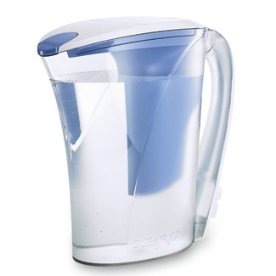
Reverse Osmosis
solvent is pumped through semi-impermeable membrane at a pressure greater than Π leaving behind solute particles
Used to purify water
www.goodhousekeeping.com/cm/goodhousekeeping/...
X 4

Slide 39
Colligative Properties of
Electrolytic Solutions
Why doesn’t the ocean freeze?

Slide 40
Reminder: What are Electrolytes?
They are solutions possessing ions:
They allow water to conduct electricity
Strong electrolytes dissolve completely (e.g. NaCl)
Weak electrolytes only partially dissolve (e.g. CaSO₄)
Non-electrolytes do not dissolve inwater at all and are not ionic (e.g. glycerol)

Slide 41
van’t Hoff Factor, i
Used to indicated the strength of the electrolyte

Slide 42
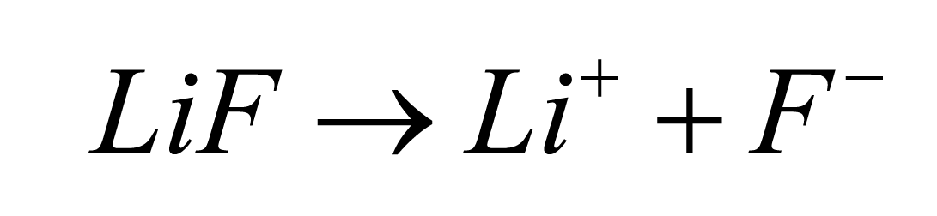
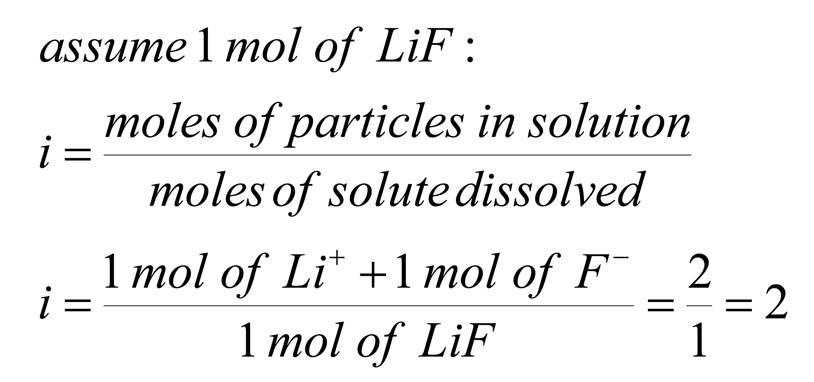
What is i for the following?
LiF

Slide 43
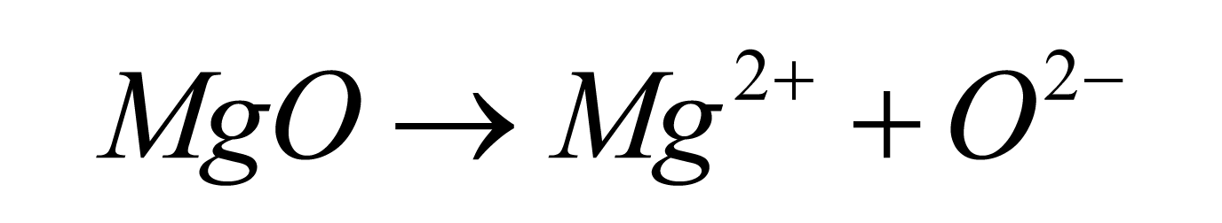
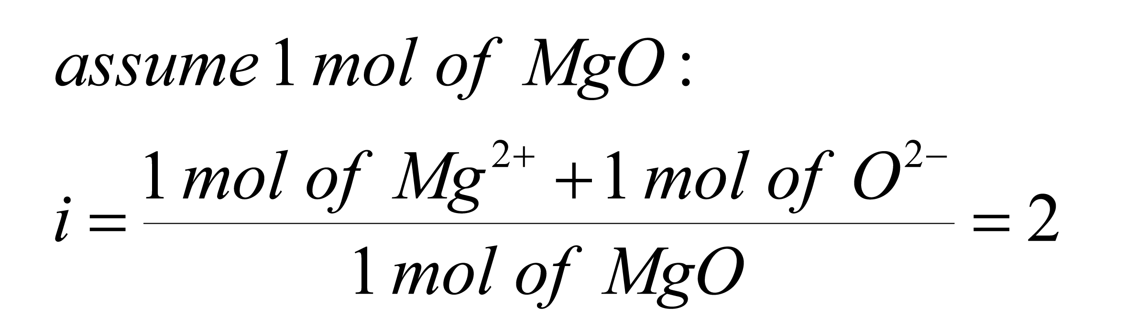
What is i for the following?
MgO

Slide 44
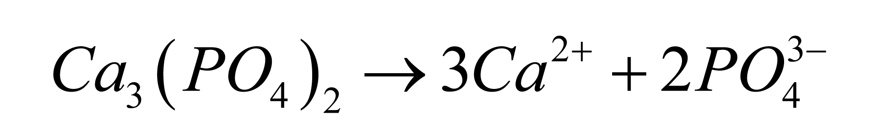
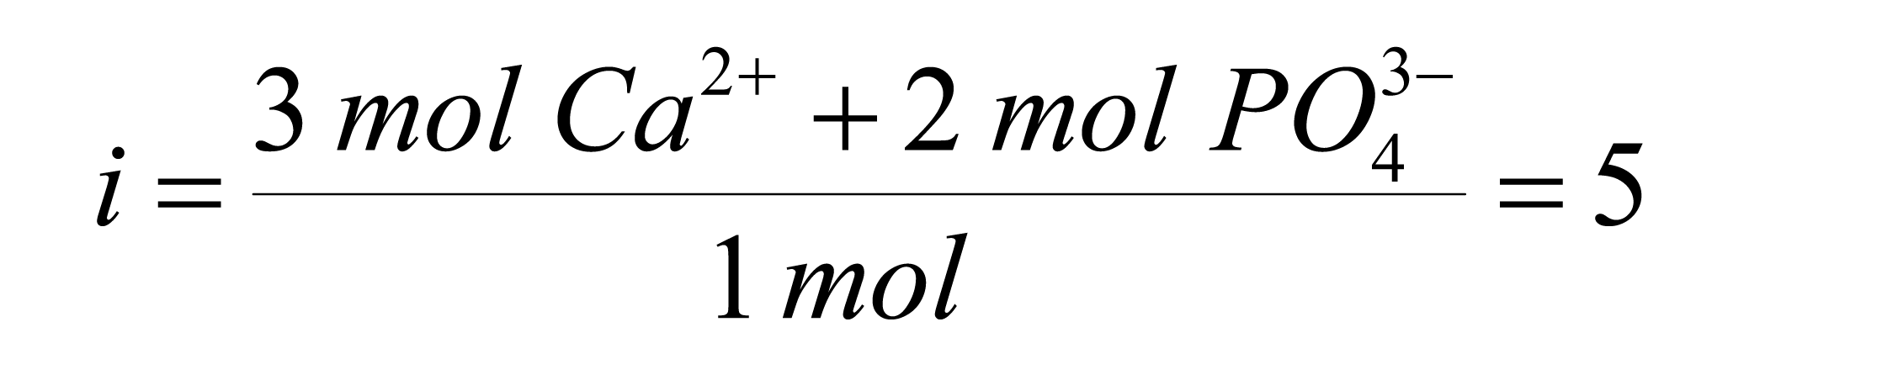
What is i for the following?
Calcium Phosphate

Slide 45
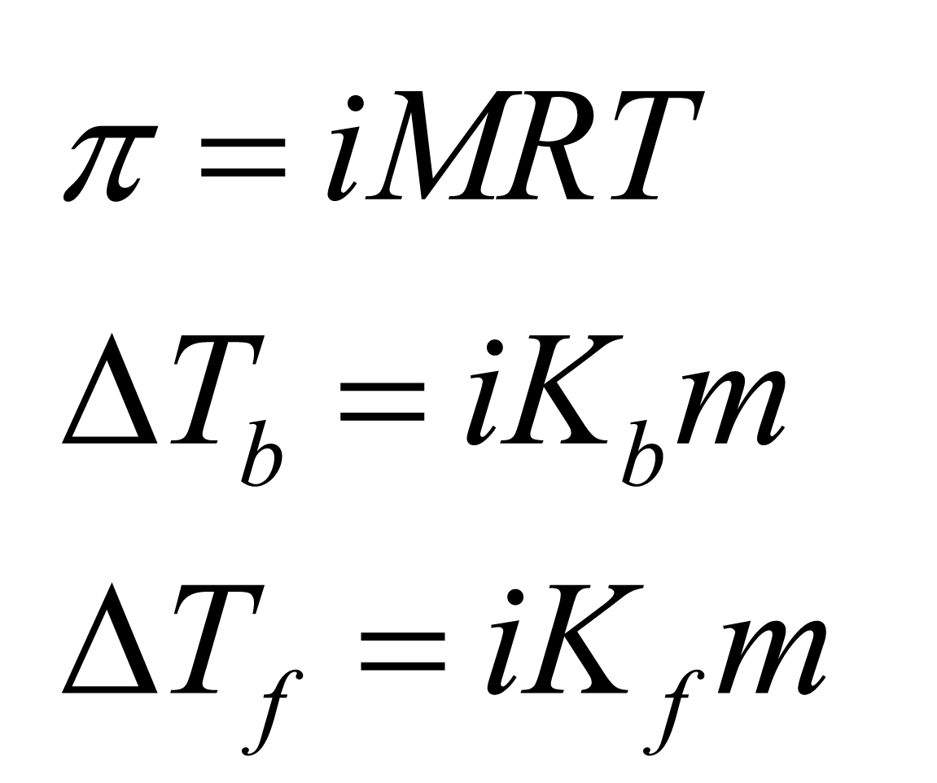
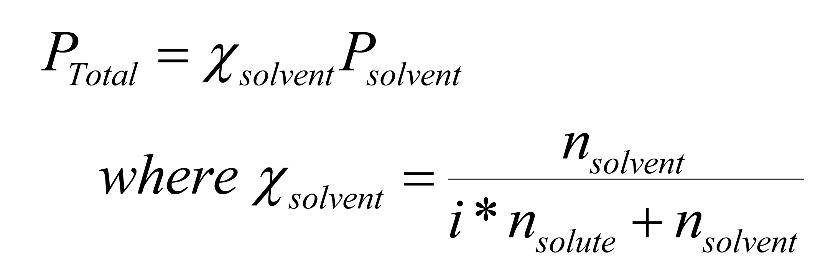
True Colligative Equations
Electrolytes DO matter!!!

Slide 46
Example Problem
The van't Hoff factor for a 0.05 m solution of magnesium sulfate is 1.3. What is the freezing point of the solution?
(Answer: ΔT_{f} = -0.12⁰C)

Slide 47
Bpt Example with i
If the boiling point of a sample is 2.3 Celcius above the boiling point of pure water, what is the molality of NaCl in the sample? (Answer: 2.2 m NaCl)

Slide 48
Conceptual Problem
For the list of compounds below rank them in order of increasing boiling point, freezing point, osmotic pressure and vapor pressure. Assume a 1.0M solution for each reagent and complete dissociation where applicable. C₁₁H₂₂O₁₁, KBr, Li₂SO₄
First, we determine i for each compound.
C₁₁H₂₂O₁₁ → i = 1
KBr → i =2
Li₂SO₄→ i = 3

Slide 49
Conceptual Problem
For the list of compounds below rank them in order of increasing boiling point, freezing point, osmotic pressure and vapor pressure. Assume a 1.0M solution for each reagent and complete dissociation where applicable. C₁₁H₂₂O₁₁, KBr, Li₂SO₄
We use i,C₁₁H₂₂O₁₁(i = 1), KBr(i =2), Li₂SO₄( i = 3),
and the mathematical equation for each trend
Boiling Point Trend:
C₁₁H₂₂O₁₁ < KBr < Li₂SO₄

Slide 50
Conceptual Problem
For the list of compounds below rank them in order of increasing boiling point, freezing point, osmotic pressure and vapor pressure. Assume a 1.0M solution for each reagent and complete dissociation where applicable. C₁₁H₂₂O₁₁, KBr, Li₂SO₄
We use i,C₁₁H₂₂O₁₁(i = 1), KBr(i =2), Li₂SO₄( i = 3),
and the mathematical equation for each trend
Freezing Point Trend:
Li₂SO₄ < KBr < C₁₁H₂₂O₁₁

Slide 51
Conceptual Problem
For the list of compounds below rank them in order of increasing boiling point, freezing point, osmotic pressure and vapor pressure. Assume a 1.0M solution for each reagent and complete dissociation where applicable. C₁₁H₂₂O₁₁, KBr, Li₂SO₄
We use i,C₁₁H₂₂O₁₁(i = 1), KBr(i =2), Li₂SO₄( i = 3),
and the mathematical equation for each trend
Osmotic Pressure Trend:
C₁₁H₂₂O₁₁ < KBr < Li₂SO₄

Slide 52
Conceptual Problem
For the list of compounds below rank them in order of increasing boiling point, freezing point, osmotic pressure and vapor pressure. Assume a 1.0M solution for each reagent and complete dissociation where applicable. C₁₁H₂₂O₁₁, KBr, Li₂SO₄
We use i,C₁₁H₂₂O₁₁(i = 1), KBr(i =2), Li₂SO₄( i = 3),
and the mathematical equation for each trend
Vapor Pressure Trend:
Li₂SO₄ < KBr < C₁₁H₂₂O₁₁

Slide 53
Example VP Problem with i
What is the VP of a solution containing 1L of water and 500 g of NaCl? (at 25⁰C the VP of water is 23.8 torr) (Answer: 18.2 torr)
X 3

Slide 54
Section 13.6
Colloids

Slide 55
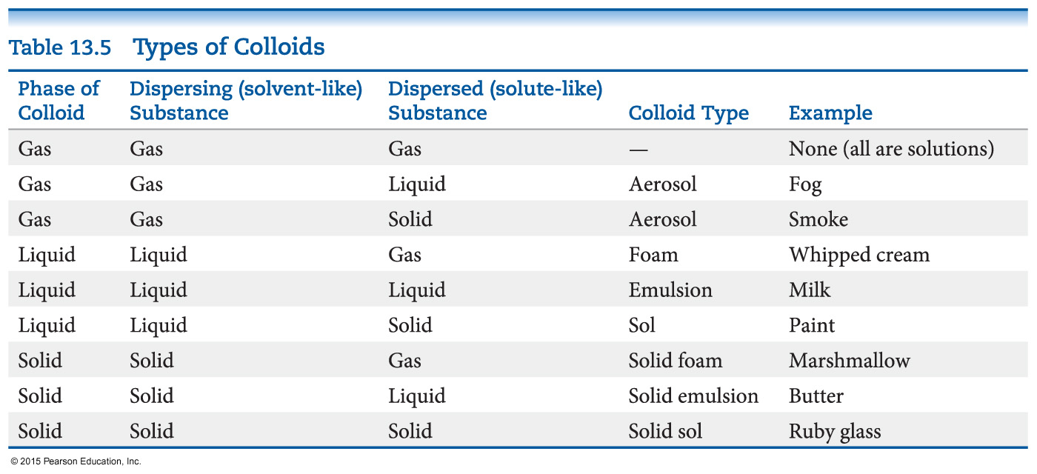
Colloids
Suspensions of particles larger than individual ions or molecules, but too small to be settled out by gravity, are called colloids.

